Slide 1
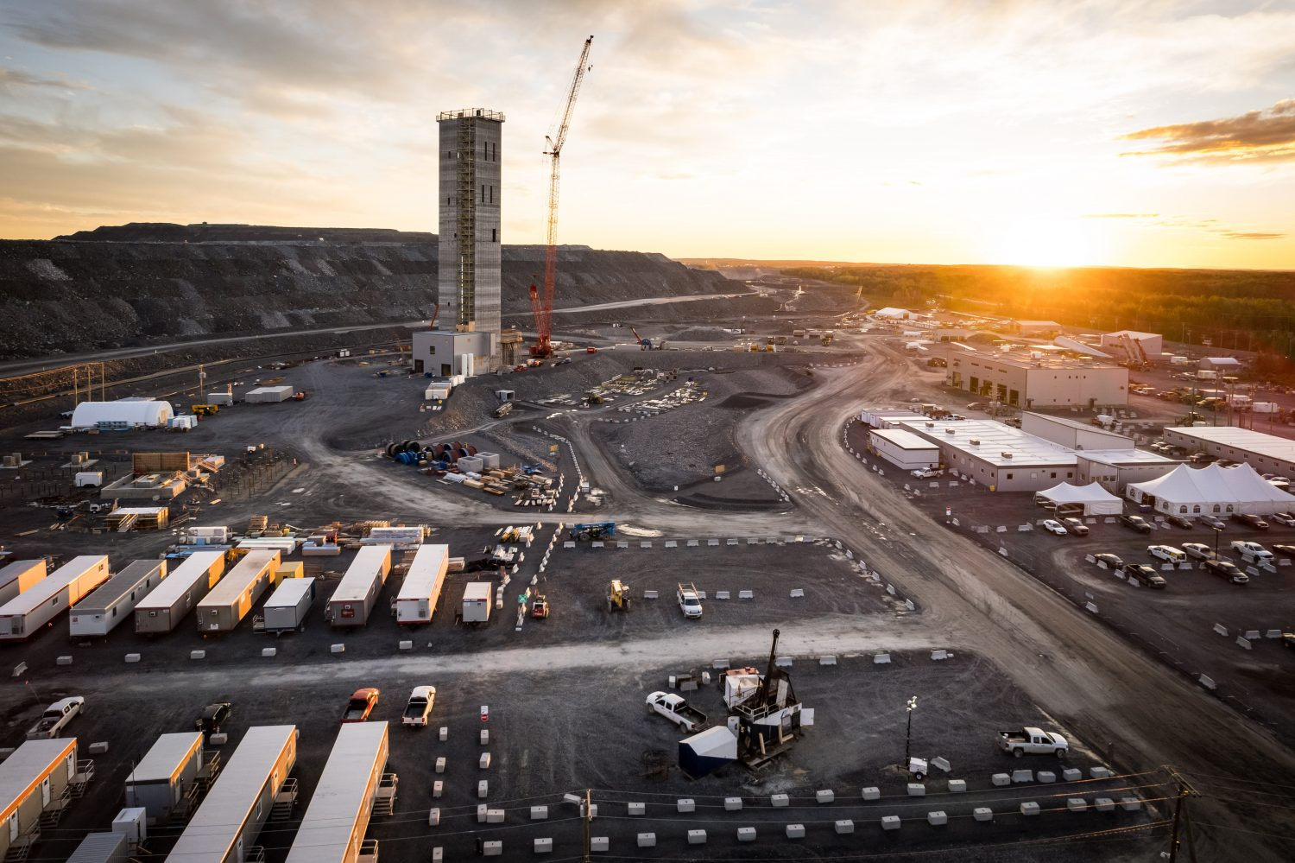


Output Workflow

Slide 2
Manifest Table
2.5M
Preprocessing Filter Identified ~1.2M
Not-prefiltered: Motion sensed and
Large File Size photos ~1.2M
MegaDetector Binary Model identified
91,098 Images might have Animals
~1.2M+91,098=1,279,887
Model 1: MegaDetector v5a
Model 2: MegaDetector v6b-yolo9c
Tagged by either
of the models:
956,874 Images
Human:
1,368 Images (0.05%)
Animal:
5,458 Images (0.22%)
Vehicle:
334,250 images (13.37%)

